Slide 1
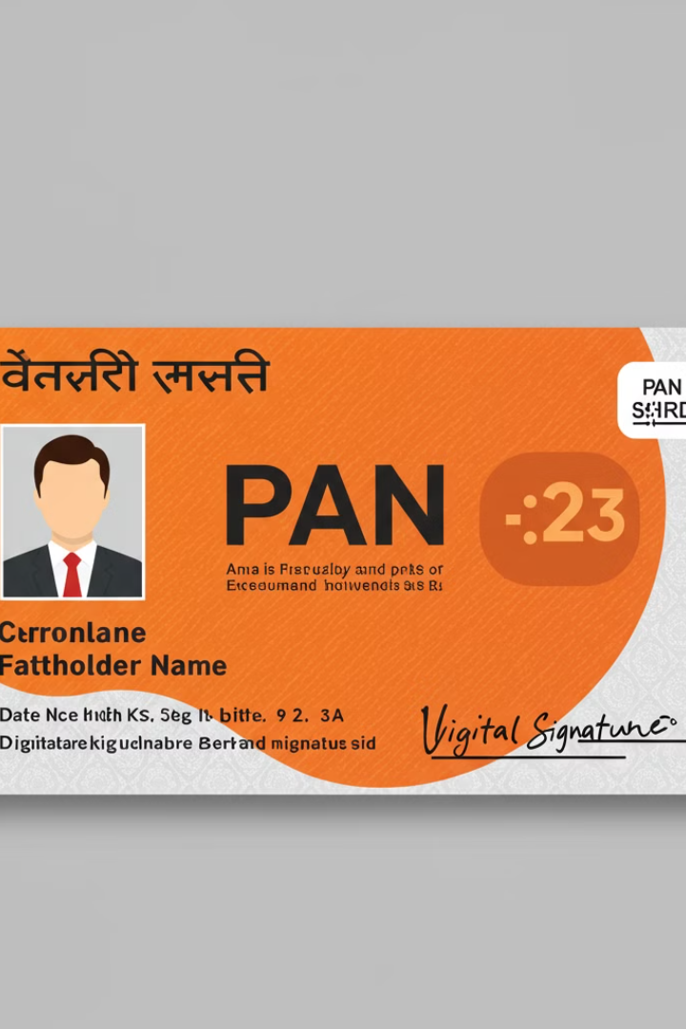

What is a PAN Card?
A PAN Card (Permanent Account Number) is a 10-digit unique identification number issued by the Income Tax Department of India. It is used to track financial transactions and is mandatory for activities like filing income tax returns, opening a bank account, or conducting high-value transactions.
by Ram N Java

Slide 2

What Does a PAN Card Contain?
1
Your Name
2
Your PAN Number
Your full name as per official records.
A 10-digit alphanumeric code (e.g., ABCDE1234F).
3
Your Father's Name
4
Your Date of Birth
Your father's name (for identification purposes).
Your birth details.
5
Your Photo
6
Your Signature
A photograph for identification.
Your digital signature for verification.

Slide 3

Why is a PAN Card Important?
Income Tax Filing
Bank Account
High-Value Transactions
Required for filing income tax
returns.
Needed for opening a
bank account.
Mandatory for transactions like buying property, investing in mutual funds, or purchasing jewelry above a certain limit.
Business Purposes
Identity Proof
Used for business registration and tax compliance.
Acts as a valid identity proof for official purposes.

Slide 4

How to Apply for a PAN Card?
Online Application
Visit the official website of NSDL or UTIITSL.
Fill out the PAN application form (Form 49A for Indians).
Upload your photo, signature, and supporting documents (like Aadhaar, passport, or voter ID).
Pay the application fee online.
Offline Application
Visit a PAN service center.
Submit the filled application form along with documents and fee.
Track Your Application
Use the acknowledgment number to track your application status online.
Receive Your PAN Card
Once approved, your PAN card will be sent to your address by post.

Slide 5
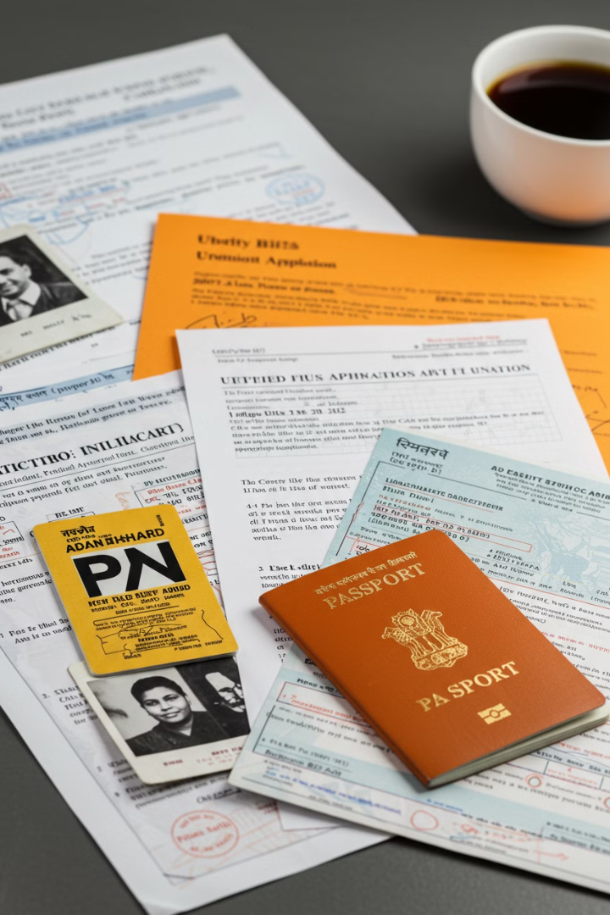




Documents Required for PAN Card
Proof of Identity
Proof of Address
Proof of Date of Birth
Aadhaar, passport, voter ID, or driving license.
Aadhaar, utility bill, or rent agreement.
Birth certificate, school certificate, or passport.
Passport-Size Photo
Recent photograph.

Slide 6
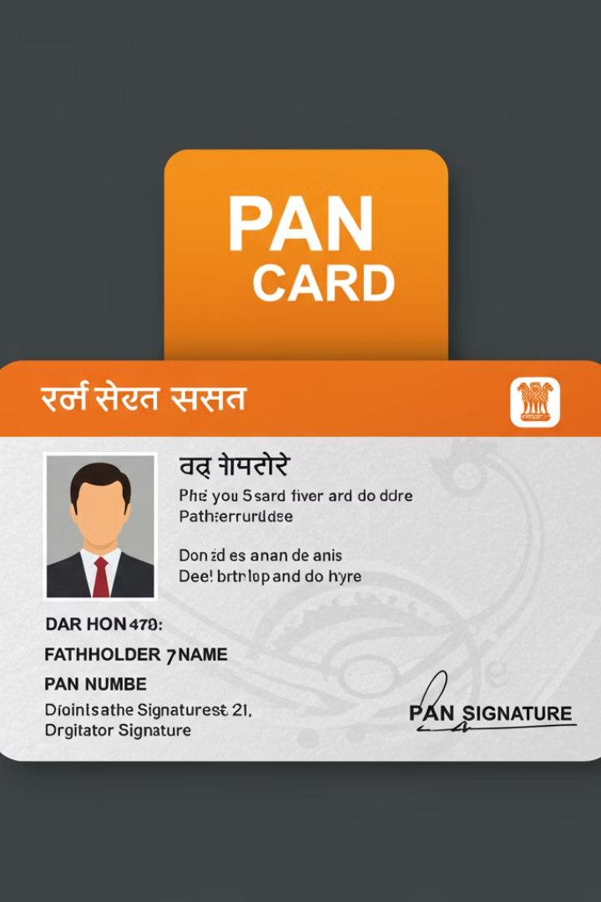




Advantages of PAN Card
Tax Compliance
Helps in filing income tax returns and tracking financial transactions.
Universal Acceptance
Accepted as identity proof across India.
Prevents Tax Evasion
Ensures transparency in high-value transactions.
Easy to Apply
Simple online and offline application process.

Slide 7

Disadvantages of PAN Card
Mandatory for Many Transactions
Risk of Misuse
Some people find it inconvenient to provide PAN for every transaction.
If lost or stolen, it can be misused for fraudulent activities.

Slide 8




Important Things to Know About PAN Card
Linking with Aadhaar
One Person, One PAN
It is mandatory to link your PAN with Aadhaar.
Each individual can have only one PAN.
1
2
Keep It Safe
4
3
Update Details
Do not share your PAN number with unknown people to avoid fraud.
You can update your PAN details (like name or address) if they change.

Slide 9




Conclusion
Essential Document
1
The PAN Card is an essential document for financial activities
Multiple Uses
2
Helps in filing taxes and opening bank accounts
High-Value Transactions
3
Necessary for conducting high-value transactions
Security
4
Always keep your PAN details safe and use them responsibly

